Slide 1
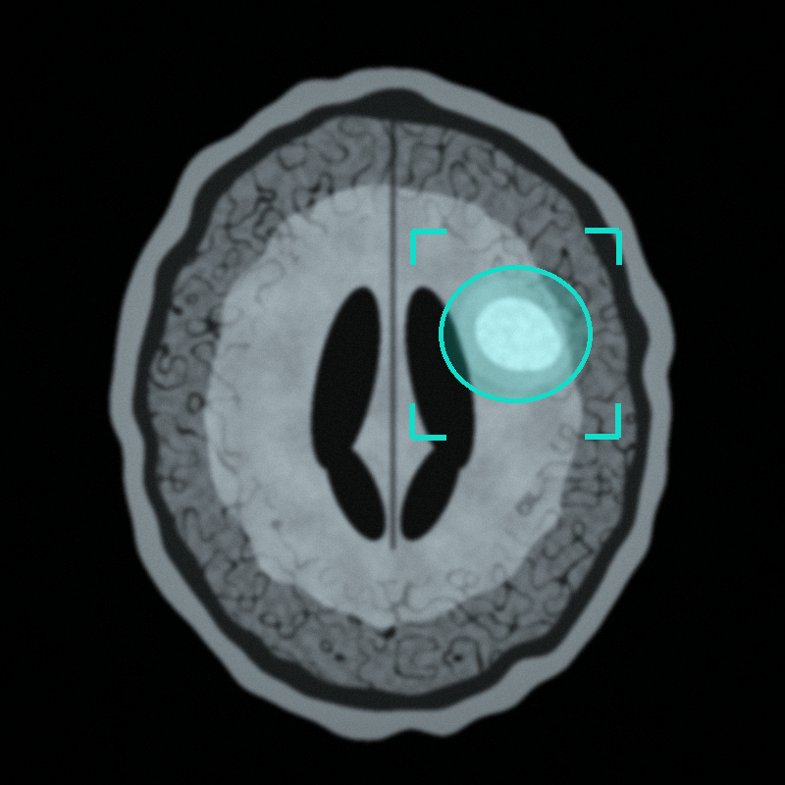
RESEARCH PROTOTYPE | CONCEPT STAGE
NeuroGuard AI
An AI-Powered Brain Tumor Early Detection and Classification Support System
Student: [Student Name]
Department: Computer Science & Engineering (AI & ML)
College: [College Name]
Project Guide: [Guide Name]
Not a clinically approved diagnostic tool
Notes:
Introduce NeuroGuard AI as a proposed research prototype that supports doctors in reviewing brain MRI scans. Stress that it is a concept-stage student project and not a clinically approved tool. Fill in the student, college and guide names on this slide.

Slide 2
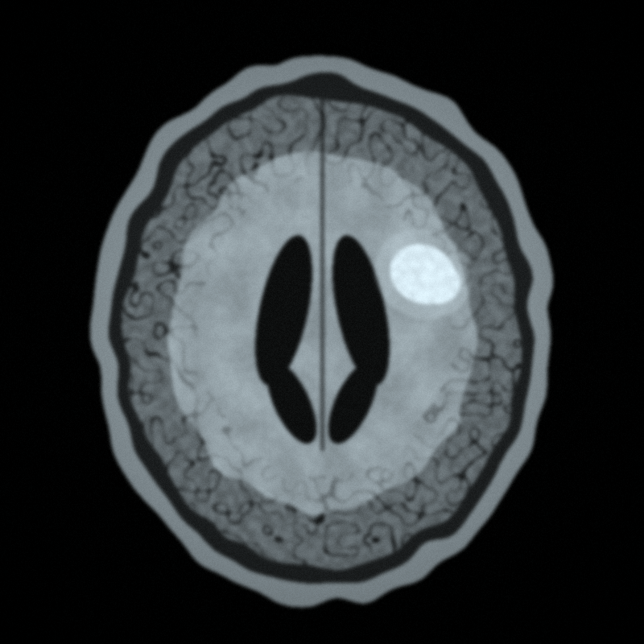




Introduction
What is a brain tumor?
An abnormal growth of cells in or near the brain.
Why look early?
Spotting suspicious areas sooner may help doctors plan further checks.
Role of AI
AI can learn patterns in MRI images and point out regions to review.
Doctors decide
AI only supports the review. Diagnosis stays with doctors.
Illustrative MRI-style image (synthetic, not a real patient scan)
NeuroGuard AI | Research prototype, not a diagnostic tool
Notes:
Explain a brain tumor in simple words. Early identification of suspicious areas can help clinical assessment, but only doctors can diagnose. AI is introduced as a helper that analyzes medical images.

Slide 3

Problem Statement
Specialist expertise
Time-consuming
Reading brain MRI scans by hand needs trained specialists.
Reviewing large numbers of scans can take a lot of time.
Closer examination
Need for support tools
Suspicious regions may need a second, closer look.
AI-assisted image analysis should be studied as a helper for doctors.
Our question: how can AI support doctors in reviewing brain MRI scans?
NeuroGuard AI | Research prototype, not a diagnostic tool
Notes:
Manual MRI review needs expertise and time. Some regions need closer examination. This motivates studying AI-assisted analysis as a support tool, not a replacement.

Slide 4
Proposed Solution
1
Accept an authorized brain MRI scan
2
Analyze it with a suitable trained AI model
3
Flag possible suspicious regions
4
Estimate a possible tumor category, when the model supports it
5
Display findings for specialist review
Conceptual region highlight (synthetic image)
NeuroGuard AI | Research prototype, not a diagnostic tool
Notes:
Walk through the five aims: accept an authorized scan, analyze with a trained model, flag suspicious regions, estimate a category when supported, and show findings for specialist review. The image on the left is a synthetic illustration.

Slide 5
Main Objectives
1
Investigate AI-assisted identification of possible brain tumors in MRI scans
Detect
2
Explore classification of supported tumor categories
Classify
3
Visualize suspicious regions using model-supported highlighting
Visualize
4
Provide a simple, understandable user interface
Interface
5
Evaluate performance and limitations using appropriate datasets
Evaluate
NeuroGuard AI | Research prototype, not a diagnostic tool
Notes:
Read the five objectives. Each is an investigation or exploration, because this is a research prototype. The last objective is about honest evaluation and limitations.

Slide 6
System Architecture
Proposed design
01
02
03
04
MRI Image Input
Image Preprocessing
Trained AI Model
Detection and Classification Output
Authorized brain scan
Resize and normalize
Existing trained model
Possible tumor category
05
06
07
Human in the loop: a doctor makes the final decision
Region Highlighting
Results Dashboard
Doctor's Review
Overlay on region
Streamlit interface
Specialist decides
Safety note: model predictions are not confirmed medical diagnoses.
NeuroGuard AI | Research prototype, not a diagnostic tool
Notes:
Follow the flow from left to right, then continue on the second row. Every box and arrow is an editable PowerPoint shape. Stress the safety note: predictions are not diagnoses and a doctor reviews the results.

Slide 7






Technologies Used
Python
Streamlit
PyTorch or TensorFlow
NumPy and Pandas
Main programming language
Web interface
AI model implementation
Data processing
The exact model and libraries will be selected during development.
OpenCV or medical-image libraries
Matplotlib or Plotly
Git and GitHub
Image handling
Visualization
Version control
NeuroGuard AI | Research prototype, not a diagnostic tool
Notes:
These are the planned tools. Python is the main language, Streamlit gives a simple web interface, and PyTorch or TensorFlow will be used for the AI model. The exact model and libraries are not final yet.

Slide 8
Working Process
Proposed workflow
1
Select an authorized MRI image
Input
2
Check image format and quality
Quality check
3
Preprocess the image according to the model requirements
Preprocess
4
Run AI inference
Inference
5
Display the model's prediction and uncertainty where available
Output
6
Highlight the suspicious region if the model supports localization
Localization
7
Generate a research summary for specialist review
Report
NeuroGuard AI | Research prototype, not a diagnostic tool
Notes:
Seven proposed steps from selecting an authorized image to a research summary for specialist review. Uncertainty and localization are shown only when the chosen model supports them.

Slide 9





Software Prototype and User Interface
Proposed Interface — Not Yet Implemented
MRI image viewer
NeuroGuard AI Dashboard
Predicted category, if supported
Predicted category
Category name (if supported)
Highlighted region or segmentation overlay, if available
Confidence / uncertainty
If the model provides it
Model confidence or uncertainty information
Case history and comparison
Previous scans, side by side
Case history and comparison, where suitable
MRI viewer + overlay
Disclaimer and clinician-review section
Disclaimer: research prototype, not a diagnosis
Clinician review
NeuroGuard AI | Research prototype, not a diagnostic tool
Notes:
This is a conceptual mockup only. It is labeled Proposed Interface, Not Yet Implemented. It shows the planned panels: image viewer with overlay, predicted category, confidence or uncertainty, case history, and a disclaimer with a clinician-review section.

Slide 10




Testing and Evaluation
Documented dataset
Data splits
Core metrics
Use a suitable, documented brain MRI dataset.
Keep training, validation and testing data separate.
Sensitivity, specificity, precision, recall and F1-score.
Segmentation metrics
Error analysis
Ethics and experts
Dice score, if segmentation is implemented.
Examine false positives and false negatives.
Seek specialist guidance and ethical approval before any clinical research.
No results are reported yet. This evaluation is planned.
NeuroGuard AI | Research prototype, not a diagnostic tool
Notes:
Explain how the prototype will be evaluated. Say clearly that there are no results yet. The metrics listed are what will be measured once the prototype is built, and any clinical research would need specialist guidance and ethical approval.

Slide 11



Future Scope — Software and Hardware
PHASE 1
PHASE 2
PHASE 3 · FUTURE
Basic Software
Advanced AI
Hardware Integration
Python and Streamlit prototype
Appropriate dataset
Existing trained model
Improve detection
Explore supported tumor classification
Test model reliability
Validate results with qualified specialists
Explore a secure medical imaging workstation or edge device
Hardware only supports processing and display
It cannot detect tumors without proper imaging and validated software
Future research: longitudinal MRI comparison, which means studying scans of the same person over time. This is exploratory. It is not a claim of predicting tumors before they form.
NeuroGuard AI | Research prototype, not a diagnostic tool
Notes:
Three phases. Phase 1 is the realistic student goal. Phase 2 needs specialists for validation. Phase 3 is only a future idea: hardware would only run and display validated software. Longitudinal MRI comparison is future research and does not mean predicting tumors before they form.

Slide 12

Conclusion
NeuroGuard AI proposes an AI-assisted approach to brain MRI analysis.
It aims to flag suspicious regions and estimate supported tumor categories.
The first version is feasible as a student-level Python research prototype.
Clinical reliability, safety and usefulness must be shown through proper evaluation.
Future versions may support more advanced AI and secure hardware integration.
Thank You!
“Our goal is to explore how AI can support earlier identification and more organized assessment of suspicious brain abnormalities.”
NeuroGuard AI | Research prototype, not a diagnostic tool
Notes:
Summarize: a proposed AI-assisted approach, feasible as a student research prototype, with reliability still to be demonstrated through evaluation. End with the goal statement and thank the audience.

